Slide 1
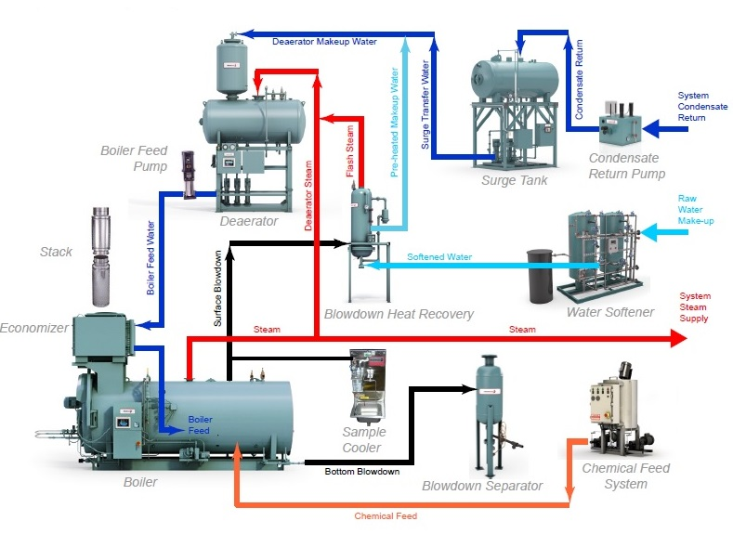
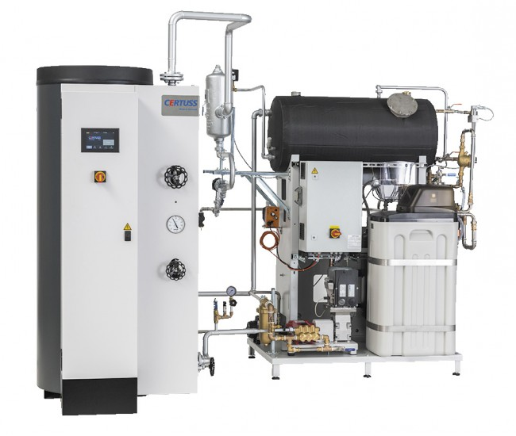
Conventional Boiler vs. Steam Generator
Steam Boiler vs. Steam Generator

Slide 2
If operating pressure & operating temperature determine the volume of water that will flash, that means that…
=> The potential explosive power of a Boiler is based on:
operating pressure setpoint & range (determines % flash)
operational water volume (% flash x volume = explosive volume)
=> Higher Pressure + Greater Water Volume = Bigger Explosion!
Cause for steam boiler failures => not correct and regular maintenance, leakages of fire tubes, gas train problems
Pressure & Power – Potential Explosive Power

Slide 3
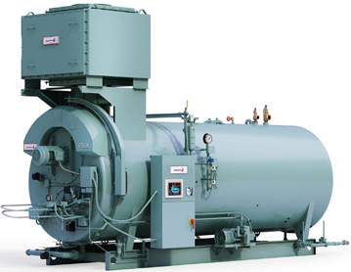
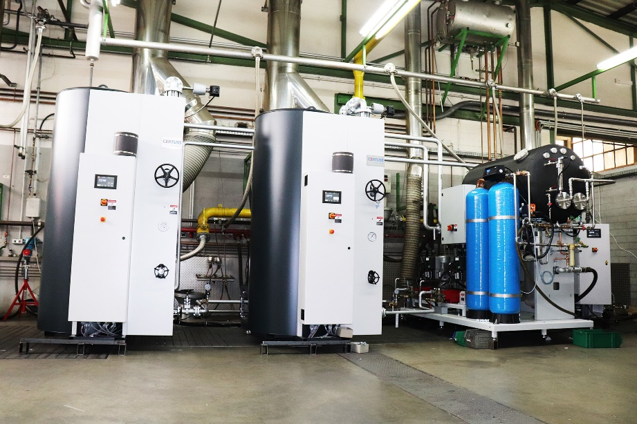
Fire Tube Boiler (100 BHP) | CERTUSS 2 x 1500 TC Steam Plant (2 x 100 BHP)
L: 13´9“ (clearance required) | L: 14´1“
W: 6´9“ | W: 5´7“
H: 6´10“ | H: 8´9“
Footprint: 95.9 ft² / 9m² | Footprint: 105.4ft² / 9,8m²
Conventional Boiler vs. Steam Generator

Slide 4
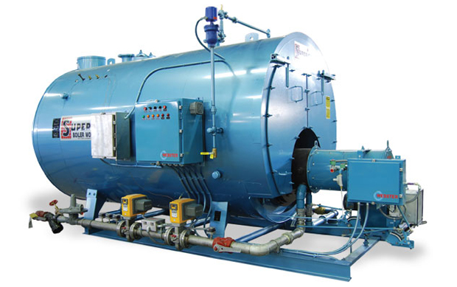
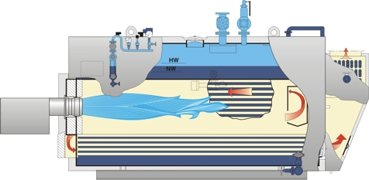
Characteristics of a Fire Tube Steam Boiler
Start-up time between 30 - 180 minutes, depending on capacity
High heat losses due to big surface and additional work for insulation
Average thermal efficiency between 75-80% US / 80-90% EU
Best operation is only when 100% load is requested
Larger and extra boiler housing and room required due to hazardous potential and high water volume, additional maintenance space required
Limited in regards of max. working pressure & susceptible to thermal-shock
Limitations in regards of remote operation and controls
Centralized design, long distribution of steam, less steam quality
Fire Tube Boiler

Slide 5
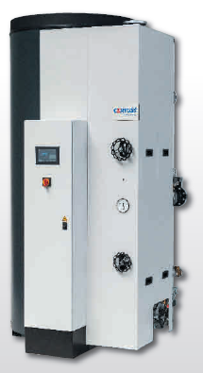
Innovation is Standard
Every CERTUSS comes with:
Intrinsically safe 460 psig MAWP / 32bar
CERTUSS Thermotimat automated start-up / shut down / blow down control system
High efficiency (87% US / 92% EU) combustion air prehear/air insulated shell
Wide range of remote control and monitoring options
Low gas pressure requirements 8“ – 20“ / 30-50mbar max
7“ Touch Control (TC) Advanced Color Touchscreen
2 section steel pressure vessel available
Steam Generator

